Slide 1
COMP 249:
Object Oriented Programming II
CHAPTER 6:
REVIEW OF ARRAYS + UNCOVERED TOPICS
CHAPTER 5:
JAVADOCS
N. ACEMIAN

Slide 2
Chapter 6 concepts will review
Covered in COMP248:
  Arrays
  Arrays as parameters and return types
  Arrays of objects
  Multidimensional arrays

Slide 3

Arrays
An array of size n is indexed from _______________
An array is an ordered list of elements of the same type
The entire array
has a single name
Each value has a numeric index
0 1 2 3 4 5 6 7 8 9
scores
79 87 94 82 67 98 87 81 74 91
This array holds 10 values that are indexed from 0 to 9

Slide 4
Arrays
The elements of an array can be:
  ___________________
  ___________________
In Java, the array itself is an object
  so the name of the array is a reference
  and the array itself must be created with new

Slide 5
Automatic Bounds Checking
The index must be [0 … length-1]
The Java interpreter checks for you…
if an array index is out of bounds -->
ArrayIndexOutOfBoundsException
  double [] codes = new double[100];
  int count = 100;
  System.out.println(codes[count]);

Slide 6
The length Instance Variable
an array is an object
length is a public constant (an attribute) that gives the
number of elements in the array
int[] scores = new int [10];
System.out.print(scores.length);
What is output?
A. 9
B. 10
C. 11
D. Syntax error – should be length()

Slide 7
Just Checking …
Given the declaration
int[] alpha = new int[75];
the valid range of index values for alpha is:
0 through 75
0 through 74
1 through 75
1 through 74
1 through 76

Slide 8

Arrays and References
In Java, an array is an object
  so an array can be passed as a parameter to a method
Like any other object:
  the reference to the array is passed
  so the formal and actual parameters become aliases of each other
passing the entire array ≠ passing a single element of the array

Slide 9
Arrays and Assignment
We can assign an array to another…
int[] a1 = {10, 20, 30};
int[] a2 = {1, 2, 3, 4, 5};
System.out.println(a1.length);
System.out.println(a1[0]);
a1 = a2;
System.out.println(a1.length);
System.out.println(a1[0]);
Output

Slide 10
Just Checking…
Consider the following array:
What is the value of
myArray[myArray[1] – myArray[0]]?
    7
    9
    -3
    6
myArray[0] | 7
myArray[1] | 9
myArray[2] | -3
myArray[3] | 6
myArray[4] | 1
myArray[5] | -1

Slide 11
Methods That Return an Array
A method may return an array
  public static int[] incrementArray(int[] a,
  int increment)
  {
  int[] temp = new int[a.length];
  int i;
  for (i = 0; i < a.length; i++)
  temp[i] = a[i] + increment;
  return temp;
  }

Slide 12
Arrays of Objects
We can have arrays of primitive types
Or we can have arrays of references to objects
1 | 2 | 10 | 6 | 25
'a' | 'd' | 'e' | 'z' | 'f'

Slide 13
Arrays of Strings
5 references to String objects
How do we represent the array words graphically?
String[] words = {"I", "am", "very", "hungry", "!"};

Slide 14
Arrays of Objects
Create the array of references – Graphically?
Create each object – Graphically?
Remember: Each object in the array must be created individually
Account[] bank = new Account[3];
bank[0] = new Account("ted", 111, 100);
bank[1] = new Account("mary", 222, 500);
bank[2] = new Account("john", 999, 5);

Slide 15
Arrays of Objects …
Manipulate each object
for (int i = 0; i < bank.length; i++) {
bank[i].deposit(100));
System.out.print(bank[i].getBalance());
}
bank
mary
ted
john
111
222
999
100
500
5

Slide 16
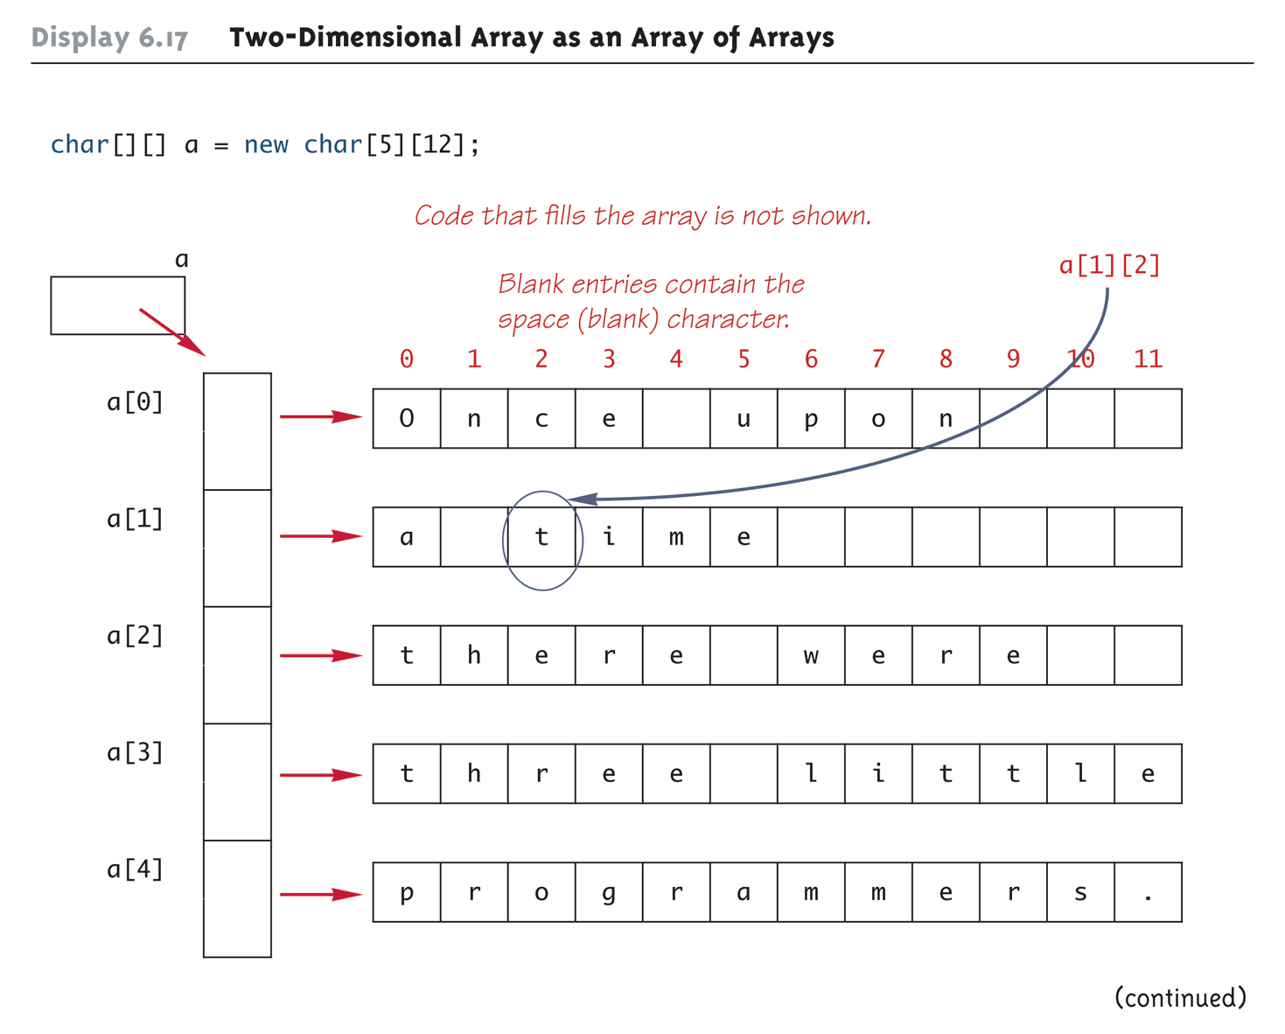
Multidimensional Arrays

Slide 17
length with multidimensional arrays
  char[][] page = new char[30][100];
length does not give the total number of indexed variables
  page.length is equal to _____
  page[0].length is equal to ______
int row, col;
for (row = 0; row < page.length; row++)
for (col = 0; col < page[row].length; col++)
page[row][col] = 'Z';

Slide 18
What is Output?
int[][] table = new int[5][10];
for (int row=0; row < table.length; row++)
for (int col=0; col < table[row].length; col++)
table[row][col] = row * 10 + col;
for (int row=0; row < table.length; row++) {
for (int col=0; col < table[row].length; col++)
System.out.print (table[row][col] + "\t");
System.out.println();
}
Output

Slide 19
Ragged Arrays – Graphically?
  double[][] a = new double[3][5];
is equivalent to:
  double [][] a;
  a = new double[3][];
  a[0] = new double[5];
  a[1] = new double[5];
  a[2] = new double[5];
So we could have:
  double [][] a = new double[3][];
  a[0] = new double[5];
  a[1] = new double[10];
  a[2] = new double[4];

Slide 20

Javadoc - From Chapter 5
(Will be covered in tutorial)
Comments in Java
// Can be single line comments
/* More than one line.
Useful to "erase" a block
of code from compilation */
/**
* A Javadoc comment
* To generate nice HTML documentation
*/

Slide 21
What is Javadoc?
A standard for documenting Java programs
javadoc.exe
  generates documentation of your Java classes in a standard format
  comes with the JDK.
For each X.java, it will create an X.html
  plus a couple of additional pages (index, ..)
ex: If you wrote MyClass.java
  then running “javadoc MyClass.java”
  generates a file “MyClass.html”
  that contains properly formatted comments

Slide 22
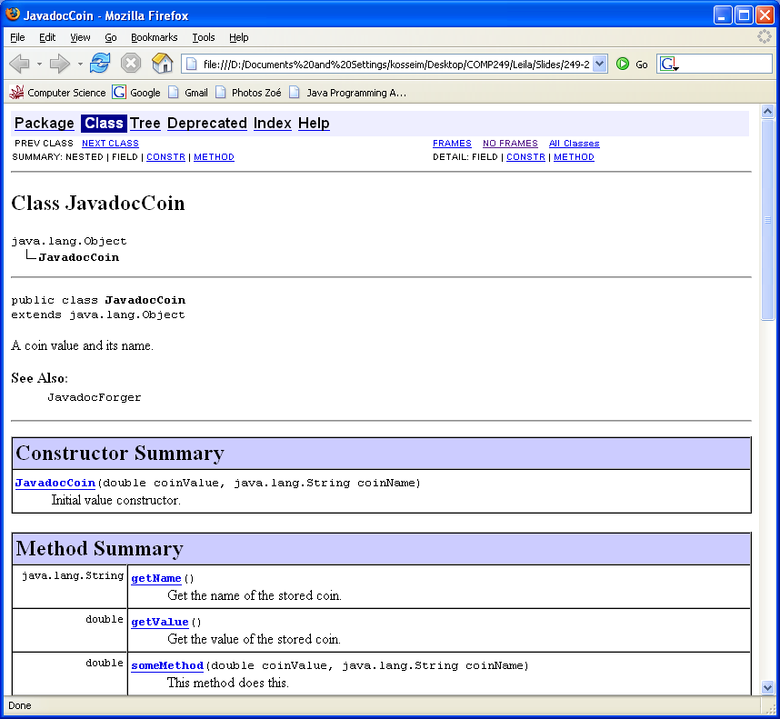

Slide 23
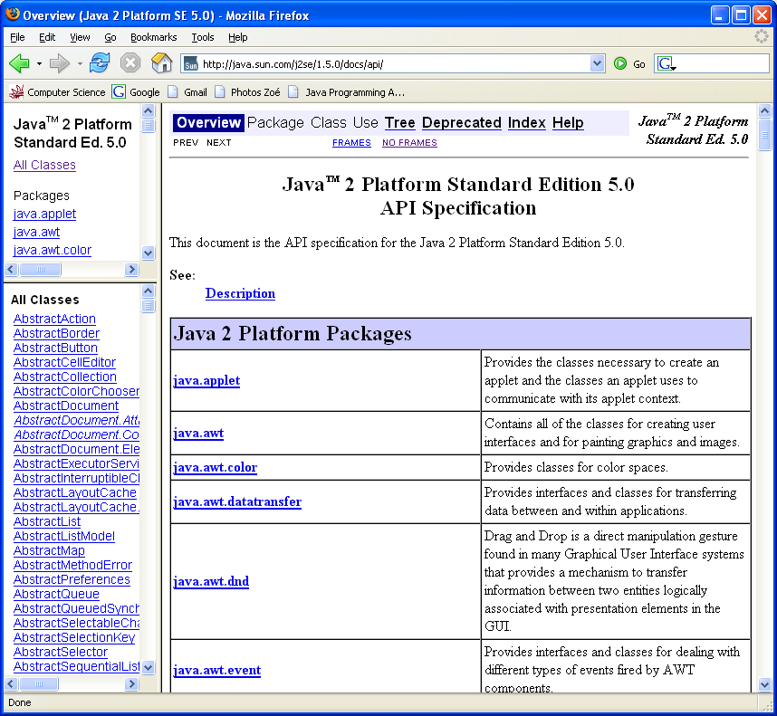
The output from Javadoc looks exactly like the API documentation… since that's the way it was generated!

Slide 24
General form
/**
* One sentence ending with a period describing the purpose.
* Additional lines giving
* more details (html tags can be included)
*
* javadoc tags to specify more specific information,
* such as parameters and return values for a method
*
* @Tag Description ...
* @Tag Description ...
*
*/

Slide 25
Tags
Allow you to specify specific information used in the HTML file
most common tags:
  For files, classes and interfaces:
    @author Name
    @version Version number
  For methods:
    @param name description
    @return description
    @exception exceptionClass description
    @deprecated description
  For everything:
    @see relatedReference (ex. other class name)

Slide 26
Documenting Files, Classes and Interfaces
Javadoc comments go immediately before the class or interface (or top of file)
ex:
  /**
  * A coin value and its name.
  * @author YourNsmr
  * @version 1.1
  * @see JavadocForger
  */
  public class JavadocCoin {
  …
  }
javadoc -author -version Javadoc.java

Slide 27
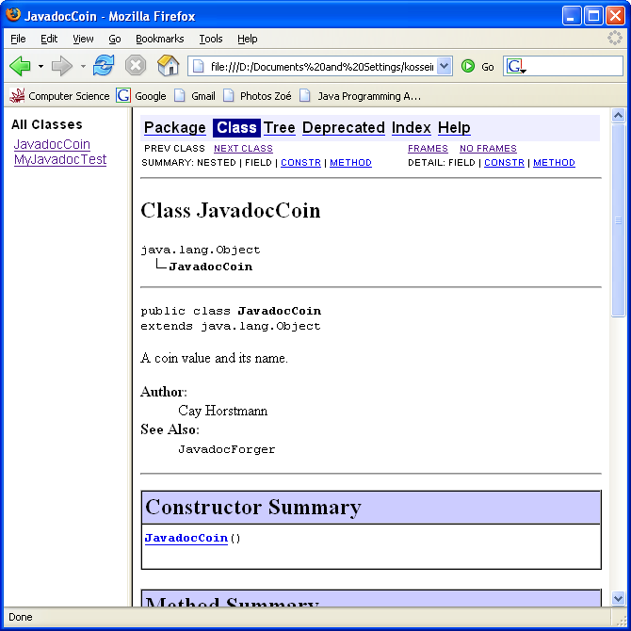

Slide 28
Documenting Methods
Javadoc comments go immediately before the method definition
Common tags :
  @param <name of parameter> <description>
  @return <description>
ex:
/**
* This method does this.
* @param coinValue Initial coin value
* @param coinName Initial coin name
* @return The value of the coin
*/
public double someMethod(double coinValue, String coinName){
…
}

Slide 29
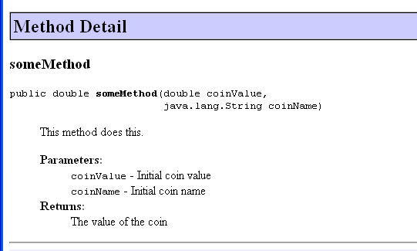

Slide 30
Javadoc
can add Html tags to the comments to add nicer formatting to the resulting document.
Advantages:
  looks very nice…
  provides a consistent look and feel to API documents
  when source code is changed:
    the Javadoc comments can be changed in the source, at the same time.
    the external documentation is then easily re-generated.

Slide 31
Chapter 6 covers …
Covered in COMP248:
  Arrays 
  Arrays as parameters and return types 
  Arrays of objects 
  Multidimensional arrays 
New in COMP249
  Enumerated types
  Methods with variable number of parameters

Slide 32
Enumerated Types
New in Java 5.0
A user-defined type
  so you need to specify all possible values
To define an enumerated type:
  enum WorkDay {MONDAY, TUESDAY, WEDNESDAY, THURSDAY, FRIDAY}
  Constants normally placed with
  by convention, values are in uppercase

Slide 33
Chapter 6 - New concepts
New in COMP249
  Enumerated types
  Methods with variable number of parameters

Slide 34
Enumerated Types
To declare a variable of an enumerated type
  WorkDay meetingDay, availableDay;
To set the value of the variable:
  meetingDay = WorkDay.THURSDAY;
  availableDay = null;

Slide 35
Enumerated Types Usage
  System.out.println(meetingDay);
  System.out.println(WorkDay.THURSDAY);
Will output: THURSDAY
Why? values of an enumerated type are not String, they are objects
  enum WorkDay {MONDAY, TUESDAY, …};
Variables or constants of an enumerated type can be compared using:
  the equals method or
  the == operator
ex: see EnumDemo.java
an object of the class WorkDay
the name of a class

Slide 36
Some Methods of Every Enumerated Type
equals
  meetingDay.equals(WorkDay.TUESDAY)
  same as meetingDay == WorkDay.TUESDAY
toString
  WorkDay.MONDAY.toString() → "MONDAY"
ordinal
  WorkDay.MONDAY.ordinal() → 0
compareTo
  WorkDay.MONDAY.compareTo(WorkDay.TUESDAY) --> neg int.

Slide 37
The valueOf & values Methods
valueOf
  WorkDay.valueOf("MONDAY") --> WorkDay.MONDAY
  very useful in a switch…
values
  to cycle through all the values of the type
  static method
  returns an array whose elements are the values of the enumerated type
see EnumValuesDemo.java

Slide 38
Methods with a Variable Number of Parameters
New in Java 5.0
Can be defined that take any number of arguments
int result3 = max(4, 5, 7);
int result2 = max(4, 5);
public static int max(int... arg)
{
  if (arg.length == 0) {
  System.out.println("Fatal Error: maximum of zero values.");
  System.exit(0);
  }
  int largest = arg[0];
  for (int i = 1; i < arg.length; i++)
  if (arg[i] > largest)
  largest = arg[i];
  return largest;
}

Slide 39
Examples
VariableParameterDemo.java
UtilityClass.java
StringProcessingDemo.java
Utility2.java

